Slide 1
Data Analysis on IBM HR Analytics
Jaylon Kiper Sheridan Payne

Slide 2
Background
The dataset chosen covered the IBM company’s human resources analytics based on their employees’ attrition and performance
The dataset includes 35 distinct variables initially:
Age
Hourly wage
Department
Education level
Job role
Estimated to be a yearly coverage for HR to analyze their employees and keep track of their overall progress

Slide 3
Machine Learning Model
K-Nearest Neighbor --- shows relationship between variables
The dataset contains many discrete variables and was straightforward
Calculations:
Used SKLearn package in Python
Split data using 5 variables: DailyRate, HourlyRate, PercentSalaryHike, YearsAtCompany, Attrition
Fit variables to model and predict future values of Attrition using other four variables
Used metric package in SKLearn to calculate the accuracy, precision, recall, and f1 score

Slide 4
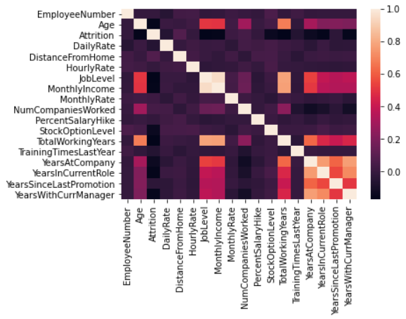
Exploratory Analysis
Correlation Heatmap showing the correlations between each numerical variable

Slide 5
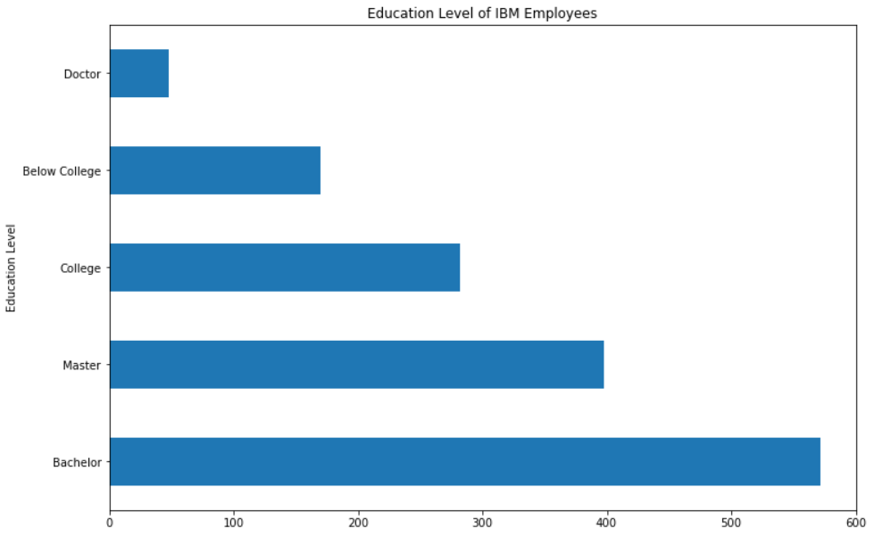
Exploratory Analysis
Count of Each Educational Level of IBM Employees

Slide 6
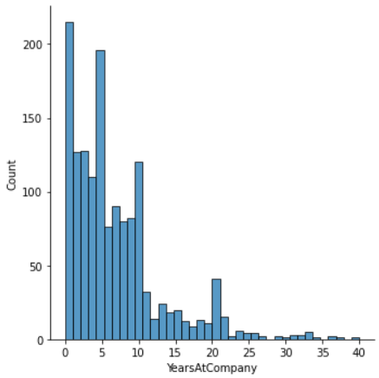
Exploratory Analysis
Count of IBM Employees by YearsAtCompany

Slide 7
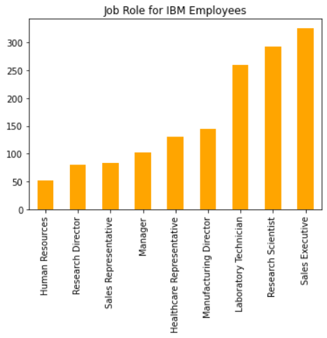
Exploratory Analysis
Count of Each Job Role of IBM Employees

Slide 8
Experimental Design
Experiment #1
Experiment #2
Experiment #3
All four (4) raw / normalized features with 80/10/10 split for train, validate, and test
All four (4) raw / normalized features with 75/15/15 split for train, validate, and test
All four (4) raw / normalized features with 50/25/25 split for train, validate, and test

Slide 9
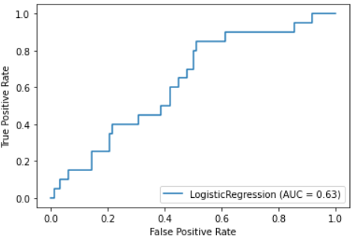
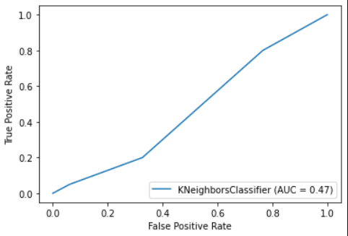
Results -- Experiment 1 (80/10/10)

Slide 10
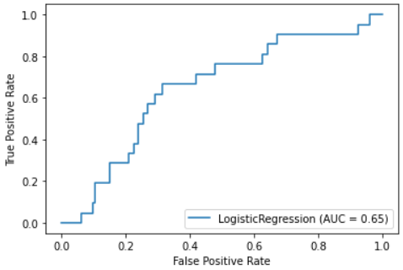
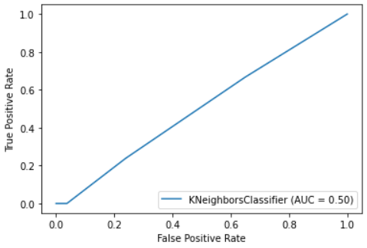
Results -- Experiment 2 (75/15/15)

Slide 11
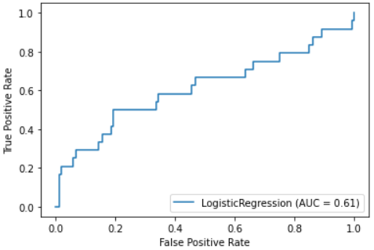
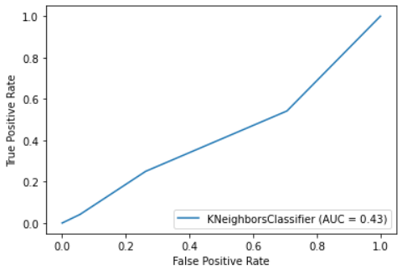
Results -- Experiment 3 (50/25/25)

Slide 12
Conclusion
Problems Encountered
Had to convert specific columns from strings to integers in Excel before importing the dataset into Python
Limitations of Implementation
ROC curve based on both K-Nearest Neighbor and Logistic Regression created messy graphs and curves
Logistic graphs had a higher AUC (Area Under a ROC Curve) than the K-Nearest Neighbor graphs
Future Work
Use a different model to see results and compare to the K-Nearest Neighbor model

Slide 13
Questions?

Slide 14
Reference
pavansubhash. (2017). IBM HR Analytics Employee Attrition & Performance. [Data Set]. Retrieved from https://www.kaggle.com/pavansubhasht/ibm-hr-analytics-attrition-dataset.

